Slide 1
Centre OF SOCIAL AND PSYCHOLOGICAL SCIENCES SAS
www.cspv.sav.sk

Slide 2
CSPS SAS: Who we are?
Centre of Social and Psychological Sciences at Slovak Academy of Sciences (www.cspv.sav.sk)
Since October 2015
Staff: 60 researchers, 10 administration and services, 16 full-time PhD students
3 organizational units:
Institute of Social Sciences in Košice; since 1975
Institute of Experimental Psychology in Bratislava; since 1955
Institute for Forecasting in Bratislava; since 1989

Slide 3
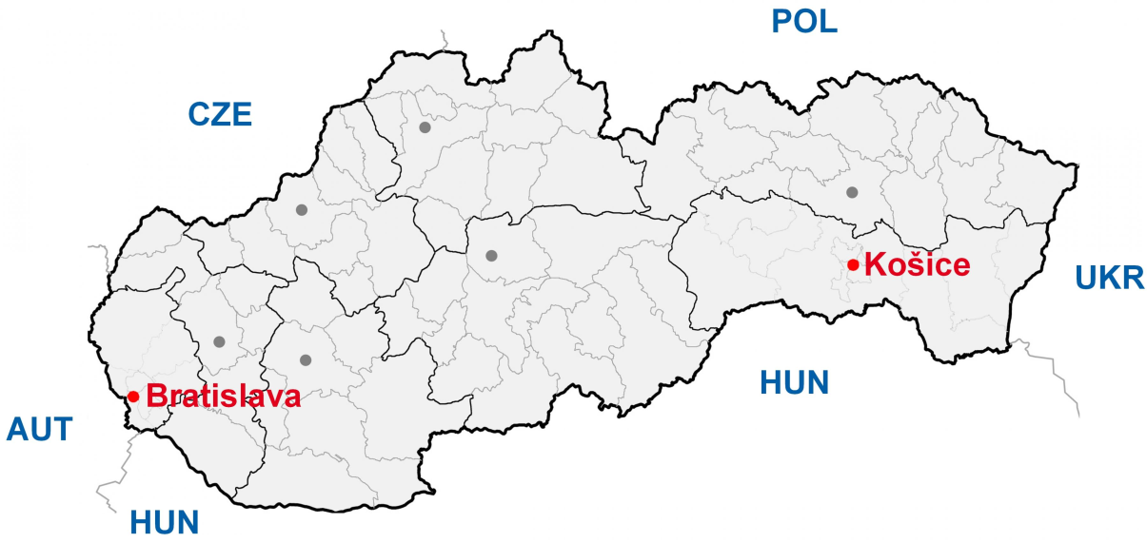
CSPS SAS: What we do?
Researching PAST-PRESENCE-FUTURE
Multidisciplinarity (PSYCHOLOGY, ECONOMICS, HISTORY, Sociology & Environmental science)
Basic and applied research; Surveys
Offices across Slovakia in Bratislava and Košice

Slide 4
We are open to cooperation
Social perception of migration
Risk related to migration
Measuring attitudes towards (climate) change
Climate change beliefs
Labour market changes
Feelings of safety
Energy preferences
Hate speech
Labour Market accessibility
Marginalized groups
Work as a source of social In/Exclusion
Digitalisation
Retirement or Late career

Slide 5
CSPS SAS: Our team

Slide 6
Recent Projects
European Social Survey (ESS ERIC) - since 2004
Horizon Europa PACES (since 2023) Norway grants SK-UA cross-border cooperation (2020-2021) Interreg - The Danube Transnational Programme – since 2017
Horizon 2020 ENTRANCES – since 2020

Slide 7
PhD studies
3 Programmes:
Social and work psychology
Public politics and Public administration
General and experimental psychology
1 Waiting...
Slovak History

Slide 8
Expert work
Fields: social psychology, work psychology, cognitive psychology, sociology, economy, environment/climate change, history
Coordinating European Social Survey in Slovakia
Survey methodology; Reproducibility (Open Science) Network
Foresights, Policy papers
Trainings
Reports and documents for state/governmental organizations

Slide 9
Our Strengths
International Projects: Multidisciplinarity and cooperation
Popularization of research/science
Publications
Successful postdocs (Schwarz fund, compensating contribution)
CSPS SAS Journals:
Studia Psychologica; https://www.studiapsychologica.com/
Individual and Society; http://www.clovekaspolocnost.sk/en/
Foresight, Analysis and Recommendations; http://www.prog.sav.sk/index.php/en/archive-forecasting-work

Slide 10
Thank you for your attention!
Please contact us:
dfedak@saske.sk
svuinfo@saske.sk
exps-info@savba.sk
progasis@savba.sk

